Slide 1

Saving Lost Intents in Network Configurations
Microsoft
Jianqiang Li¹, Wenlong Ding¹, Zhixiong Niu², Yongqiang Xiong², Hong Xu¹
¹The Chinese University of Hong Kong, ²Microsoft Research Asia
Notes:
Good morning everyone. I'm Jianqiang Li from CUHK, and this is joint work with Microsoft Research Asia.
Today I want to talk about a question every network operator has asked, and almost nobody can answer. You stare at a line in a config file and you wonder, why is this thing even here?

Slide 2



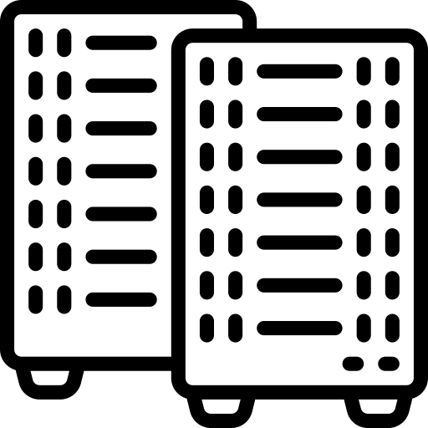
Background: NetOps in Brownfield Environments
Production configs accumulate modifications, hotfixes, migrations, and temporary exceptions.
Many original design intents have been lost to personnel churn and documentation decay.
Operators can often determine what a rule does, but not why it exists.
External
Traffic
Topology
Endpoints
D.cfg (excerpt):
ip access-list extended FINANCE-MAINT
deny tcp 10.1.1.0/24 host 10.2.2.10 eq 5432
permit ip any any
interface Gi0/2
ip access-group FINANCE-MAINT in
Operator Audit: I see there is a filtering rule on router D. Can I remove it now? What’s the original business intent?
3
2
3
2
Ingress a
1
A
1
C
Engineering
NetOps
3
3
1
2
1
2
Egress b
B
D
Finance
Unfortunately, there are multiple reasonable explanations:
Permanent Engineering-to-Finance isolation
Temporary annual-maintenance block
Stale exception after migration
Security Audit Blindness
Silent Policy Violation
Fear of Touch
Notes:
Configs are never designed in one clean shot. They pile up over years. Hotfixes, migrations, temporary exceptions. And meanwhile people leave and the documentation rots.
(click) So here is our operator on a routine audit. On router D she finds a rule blocking Engineering from a Finance database, and asks a fair question. Can I remove this?
(click) A verifier tells her what the rule does, not why it is there. And there are three possible stories. Permanent isolation between the departments. An annual-maintenance block. Or leftover garbage from a migration. The first means keep it forever. The last means it should have been deleted two years ago.
(click) So she leaves it alone. Rules nobody understands become untouchable, so operators fear to touch, and they only add, rarely simplify.

Slide 3
Problem Definition
Intent Recovery:
Input: A set of observed network properties within a user-specified scope
Output: A set of high-level intended policies that best explain these properties
Subject to: Consistency with known context
Intent Recovery is the inverse problem of Intent Translation.
  The inverse problem is ill-posed, i.e., the mapping from the configuration space to the intent space is one-to-many.
It’s fundamentally distinct from Verification or Specification Mining:
  Verification asks whether a property holds.
  Specification Mining asks what properties hold.
  Intent Recovery asks why a property holds.
Notes:
We call this intent recovery. You give us the network properties you observe, in whatever scope you care about, and we give back the high-level policies that best explain them.
(click) This is intent translation run backwards, and backwards it is ill-posed, because one configuration can be explained by many intents. Three stories, one rule.
(click) It is also a different question from existing tools. Verification asks whether a property holds. Specification mining asks what properties hold. We ask why. And that why is the whole talk.

Slide 4
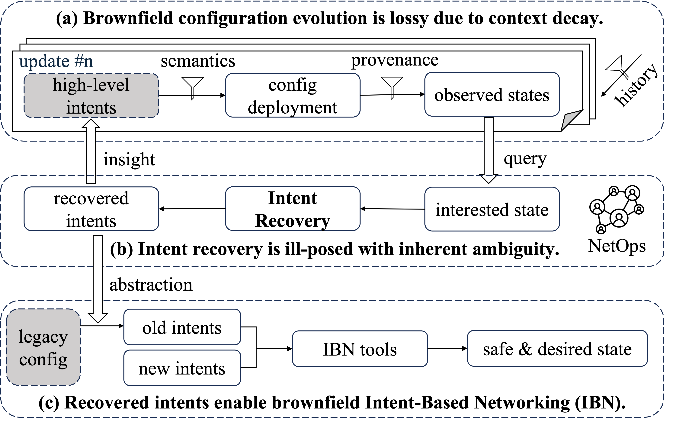
Motivation: Why Hard and Important
Context decay:
Semantics: business roles become flat IPs.
Provenance: one policy fragments across config lines/devices.
History: later updates hide earlier design rationale.
Brownfield IBN:
Current IBN often assumes a complete intent set.
Brownfield networks only have legacy configs.
Recovered intents provide constraints for safe future changes.
Notes:
So why is why so hard? Because compiling an intent into a config throws the context away. Semantics, a business role becomes a flat IP prefix. Provenance, one policy scatters across many lines and devices. History, later updates bury the earlier reasoning.
(click) And why care? Because intent-based networking today assumes you already have a complete set of intents written down. That is a greenfield assumption. Brownfield networks only have legacy configs, so they cannot adopt these tools at all. Recovered intents are the missing input, and they become safety constraints for every later change.

Slide 5
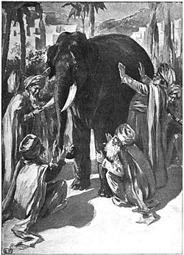
Motivation: Existing Approaches Fail
1 Manuals & Commit Logs
Abstraction-level mismatch: From 100+ PRs in a production cloud:
  69.9% implementation-centric
  24.3% process-oriented
  Only 3.9% state the intent
2 Formal Analysis (Batfish, Config2Spec, NetMiner)
Answers “What Is”, not “Why It Is.”
  Without context, formal mining methods optimizes for compactness and conflates independent policies.
3 LLM Summarization (Copilot-style)
On the same PRs:
  93.9% only paraphrase the diff
  0% infer the policy
An input-context limit, not a model-quality limit.
Each source sees only an incomplete projection of the context; none alone can recover intent.
Notes:
The natural reaction is, surely somebody already solves this. We measured three obvious candidates on a production cloud network's config repo.
Start with manuals and commit logs. Across a hundred pull requests, 70 percent just describe the edit, updated ACL X on router Y. Another 24 percent are tickets and approvals. Only 3.9 percent state the intent. Version control tracks changes, not architecture.
(click) Second, formal analysis, Batfish and friends. It answers what is, not why it is. And with no outside context, a miner optimizes for compactness, which happily merges two unrelated policies.
(click) Third, the one everybody asks about. Why not an LLM? This network already runs AI change summaries. 94 percent only paraphrase the diff, and 0 percent infer the policy. That is a context limit, not a model limit. Give it a local diff and there is nothing to reason from.
(click) So every source sees just a slice of the context.

Slide 6

Key Insight: Regularization via Context
Observation: The snapshot alone is underdetermined, but the original design leaves residual traces in surrounding artifacts.
Insight: Use context as regularization.
“Why 10.1.1.0/24 cannot reach 10.2.2.10:5432? What’s the original intent?”
Q1. What are the useful residual traces and how to mine the context?
Semantic context
(Business entity mapping)
Provenance context
(Local implementation trace)
Temporal context
(Git history of the implementation)
Q2. How to use the context to infer the original intents?
Likelihood: Does the proposed intent explain the observed network state?
Prior: Does the intent align with semantic, structural, and historical evidence?
Notes:
Here is our key observation. The snapshot alone cannot pin down the intent, but the design process left traces all around the config. So we borrow a classic idea from inverse problems, regularization. Let context constrain the answer.
(click) Take our question again. Three kinds of traces answer different parts of it. Semantic context, from IPAM, says this prefix is Engineering and that host is a Finance database, so we are talking about departments instead of integers. Provenance, from the config, says which lines produce the behavior and what sits next to them. Temporal context, from git history, says whether the rule arrived in a maintenance batch or was left behind by a migration.
(click) So the best set of intents does two things at once. The likelihood, it explains the observed state. The prior, it fits the semantic, structural and historical evidence. That is MAP inference, with context as the prior.

Slide 7
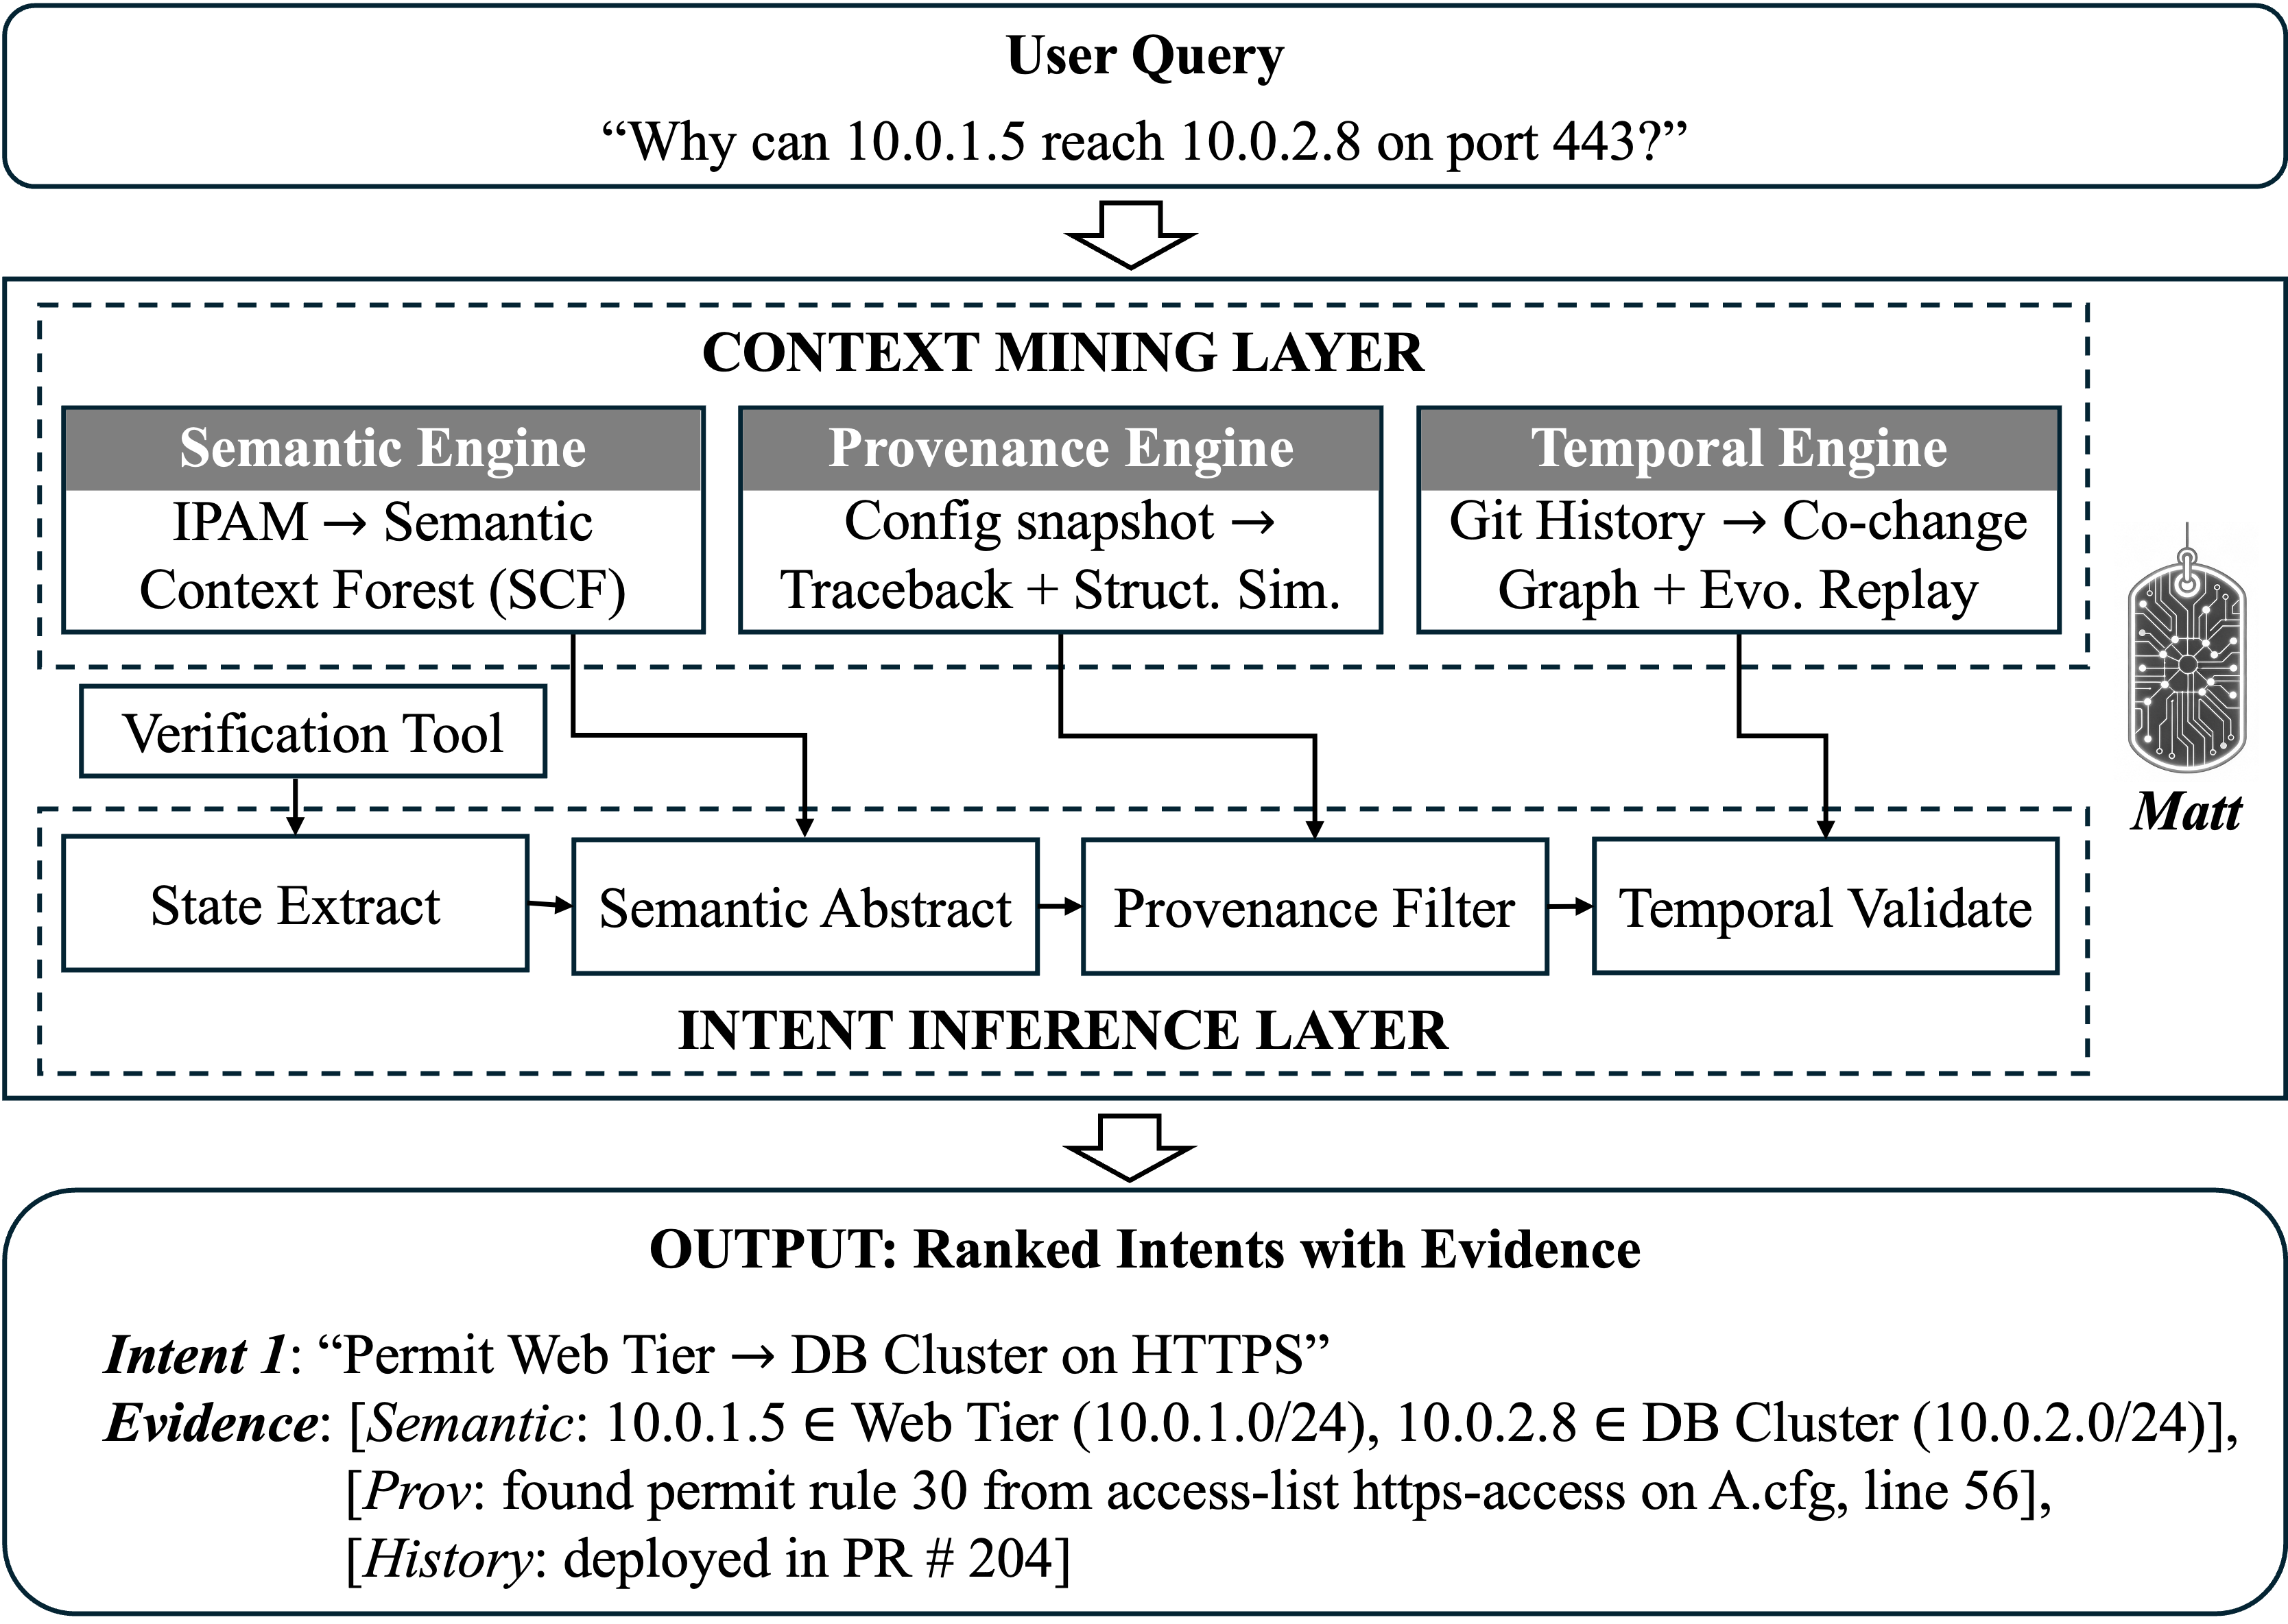
Matt Architecture
Some design choices:
Bounded task: explain a queried state, not reconstruct all policies.
Hard grounding: verification identifies behavior and contributing lines.
Soft evidence: semantics / provenance / history act as priors.
Progressive refinement: generate broad semantic candidates, then prune by structural and temporal support.
Notes:
This is our framework Matt. One layer mines context, with an engine per dimension, and one layer fuses them stage by stage. Rather than read the boxes, here are the decisions behind them.
(click) The task is bounded, explain one queried state, not the whole policy set. The facts are hard-grounded, verification gives the real behavior and the contributing lines. Everything else is soft evidence, priors, not proof. And refinement is progressive, generate broad semantic candidates first, then prune by structural and temporal support.

Slide 8
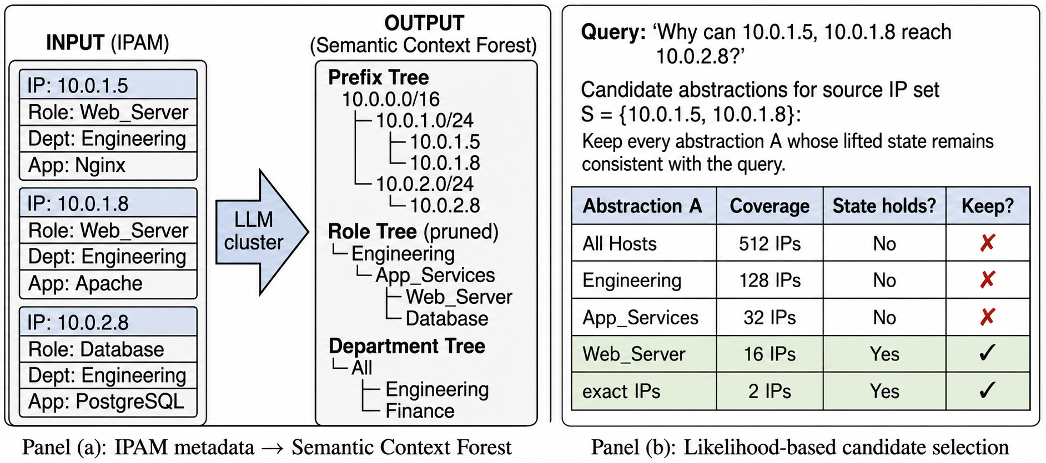
Design 1: Semantic Abstraction
Challenge: one IP sits at many levels of many hierarchies.
Semantic Context Forest (SCF): prefix and metadata hierarchies built from the IPAM table.
Candidate generation: enumerate abstractions across levels and dimensions, keeping those whose lifted state still holds.
Notes:
Step one, semantics. Any IP sits at many levels of many hierarchies at once. Host, subnet, service group, business unit, and separately location, service, security zone. Pick one and you are guessing.
So we do not pick. We build a Semantic Context Forest from the IPAM table, enumerate abstractions across all levels and dimensions, and keep every one whose lifted state still holds.
This stage is deliberately generous. Its job is recall. The next two stages filter.

Slide 9
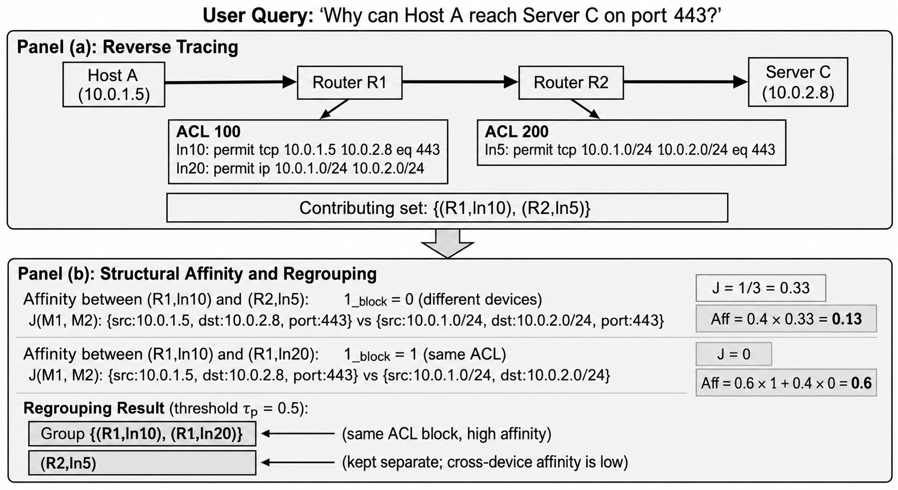


Design 2: Provenance Filtering
Challenge: business-similar flows can be unrelated in the config.
Reverse tracing:
$$𝒞_{f}=\left\{\left(d_{i} , l_{i}\right)\right\}$$
For each flow $f∈S_{Q}$, use verification to collect config lines that contribute to the queried flow/behavior.
Structural affinity:
$$Aff⁡\left(l_{i} , l_{j}\right)=α1_{ij}^{block}+\left(1−α\right)J\left(M_{i} , M_{j}\right)$$
$1_{ij}^{block}$: same config block?
$J\left(M_{i} , M_{j}\right)$: Jaccard similarity of match fields.
Group lines if $Aff⁡\left(l_{i} , l_{j}\right)≥τ_{p}$.
Reverse tracing: find the lines that produce the queried state.
Affinity & regrouping: score block locality and match-field similarity, then split candidates that lack support.
Notes:
Step two, provenance. Semantics leaves a problem. Two flows can look closely related in the business hierarchy and be completely unrelated in the actual config.
So we reverse-trace the lines that produce the queried state, then score how close they are. Same config block? Similar match fields? A high affinity means they were written together. A low one means we split the candidate apart.
This is where the configuration itself votes on which groupings are real.

Slide 10
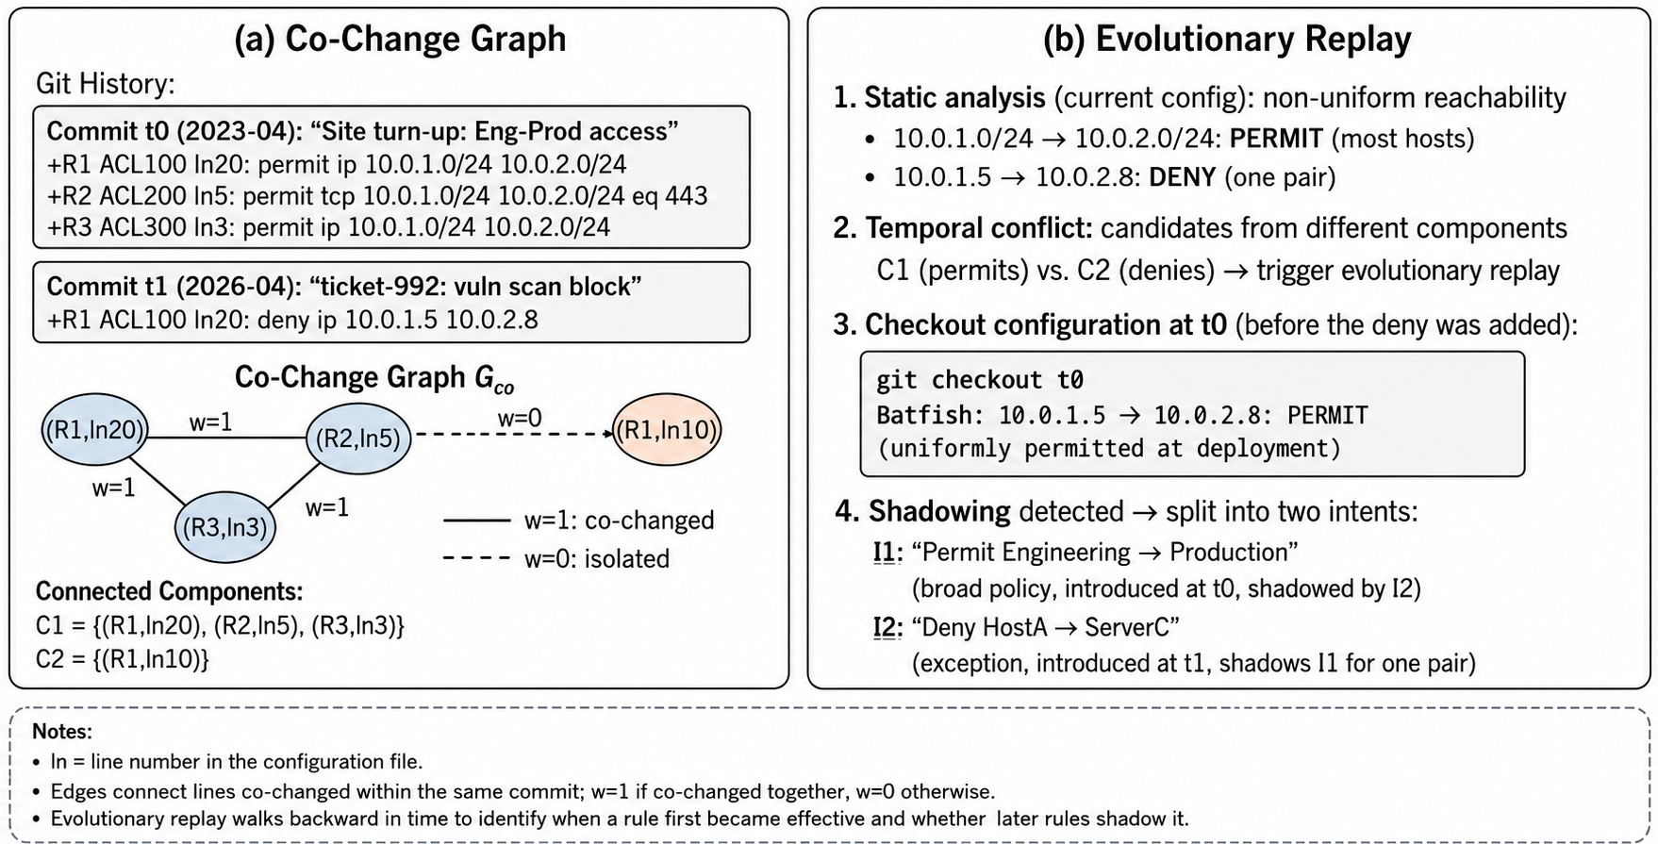
Design 3: Temporal Validation
Challenge: a permanent policy and a temporary exception look identical in current configs.
Co-change Identification: lines edited together form one deployment lifecycle.
Evolutionary Replay: when a later narrow rule shadows a broad one, replay pre-override snapshot.
Notes:
Step three, history, and this is what separates a permanent policy from a temporary exception.
First, co-change identification. A graph over commits tells us which lines were deployed together, same commit or a short window. Each connected piece is one deployment lifecycle, so those lines likely share one intent. That also catches rollouts phased across devices.
Second, evolutionary replay, for the nastier case. A later narrow deny silently shadows an older broad permit, so today's snapshot looks patchy and makes no sense. We rewind to the pre-override snapshot, rerun the query, and compare. Out come two intents, the original policy and the exception layered on later.

Slide 11
Preliminary Results
We evaluate preliminary results on a synthetic dataset.
Finding 1: Verification alone cannot recover intent
State Only: 0.03 EM / 0.04 F1
  97% of errors are over-specialization
  Explains behavior at IP/rule level, never at intent level
Finding 2: The three context dimensions are complementary
Semantics: lifts IPs into business roles
Provenance: removes over-merge (4% → 1%)
History: resolves the rest ambiguity
Together: 0.71 EM / 0.79 F1, error 80% → 29%
Notes:
We built a prototype and ask one question. Do we really need all three kinds of context?
(click) First, verification alone is nowhere close. 97 percent of its errors are over-specialization, shattering one broad policy into a pile of IP-level explanations. It answers a different question.
(click) Second, the dimensions are complementary. Semantics lifts raw IPs into business roles. Provenance cuts over-merging from 4 percent to 1. History resolves the rest.
Together, 0.71 Exact Match accuracy and 0.79 F1 score.

Slide 12
Summary & Future Work
Core problem: Production configs are often append-only.
The why is gone, and recovering it is ill-posed.
Why it is hard: Every source is partial.
Commit logs 3.9%, verification says what not why, LLM 0%.
Our insight: Regularize with the observed design trace.
Semantics + Provenance + History, fused as MAP inference.
Where this goes
A joint solver over all three dimensions.
Deployment on a production cloud network.
Unlocking brownfield IBN: safe automation for networks we already run.
Notes:
You have heard the first three boxes, so let me go straight to where this goes.
Near term, we are replacing greedy stage-by-stage pruning with a joint solver over all three dimensions. That is where the remaining accuracy is hiding.
After that, deployment on a production cloud network, and the real mess that comes with it.
But here is the bigger prize. Intent recovery is the missing front door for brownfield IBN. Recover the old intents, and the networks we already run become safe to automate, because new changes can be synthesized to provably keep the old policies intact. The greenfield assumption has kept that door shut for years, and this is how you open it.
Thank you. I am happy to take questions.

